Slide 1
Software Quality Assurance
/
Software Quality Engineering
Lecture 2
Naseer Ahmed

Slide 2
Software Quality Assurance components
Software Quality Assurance has six classes of components.
Pre-project Plan
Pre-project Plan ensures that the resources required for project, schedule, and budget should be clearly defined. Plan for development and ensuring quality has been determined.
Components are as:
Required Resources (Hardware and Human resources)
Development plan
Schedules
Risk evaluation
Quality plan
Project methodology

Slide 3
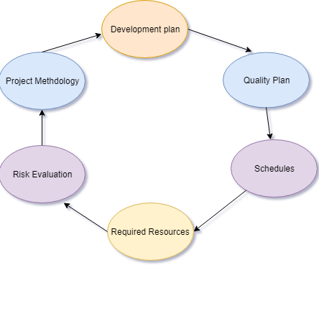
Software Quality Assurance components
Pre-project Plan

Slide 4
Software Quality Assurance components
Software Quality Assurance has six classes of components.
Project lifecycle component
A project lifecycle usually comprised of two stages:
Development Stage
In the Development Stage Component, Software Quality Assurance help to identify the design and programming errors. Its Components are divided into the following sub-classes: Reviews, Expert Opinions, and Software Testing.

Slide 5
Software Quality Assurance components
Project lifecycle component
Operation Maintenance Stage
In Operation Maintenance Stage, the Software Quality Assurance components include the Development lifecycle component along with specialized components whose aim is to improve the maintenance tasks.

Slide 6
Software Quality Assurance components
Infrastructure error prevention and improvement components
Infrastructure error prevention and improvement components
The aim of this component is to the prevention of software faults and minimizes the rate of errors.
These components are as:
Procedure and work instructions
Templates and Checklists
Staff Training, Retaining and Certification
Preventive and Corrective Actions
Configuration Management
Documentation Control

Slide 7
Software Quality Assurance components
Software Quality Management Components
Standardization, Certification, and SQA assessment components
Aim of these components is to implement international managerial and professional standards within the organization. These components help to improve the coordination among the Organizational Quality Systems and establish standards for the project process.
The component includes:
Quality management standards (What)
Project process standard (How)

Slide 8
Software Quality Assurance components
Software Quality Management Components
Quality management standards (What)
  SEI CMMI assessment standards
  ISO 9001:2008 - Quality management systems
  ISO 9001-3 - Quality Management and Quality Assurance
  Standards - Part 3: Guidelines for the application of ISO
  9001 to the development, supply and maintenance of
  software
Project process standard (How)
  IEEE 1012 standard for System and Software Verification and Validation
  ISO/IEC 12207 standard for Systems and software engineering -- Software life cycle processes

Slide 9
Software Quality Assurance components
Organizing for Software Quality Assurance ? the human elements
The main aim of this class of components is to initiate and support the implementation of Software Quality Assurance components, identify any deviations from the predefined Software Quality Assurance procedures, methods, and recommended improvements. The Software Quality Assurance organizational team includes test managers, testers, SQA unit SQA committee, and SQA forum members.

Slide 10
How many types of Software Quality Assurance Tools?
Various QA tools help with quality assurance. There are different QA tools required for different purposes. For comprehensive software quality assurance, we will need a different kind of tool which is also known as QA software.
Infrastructure
  Release Management
  Source Control
Code Reviews
  Automates Code Analysis
  Peer Code Reviews

Slide 11
How many types of Software Quality Assurance Tools?
Testing
  Test management
  Bug and Issue Tracking
  Browser, Device and OS Testing
  Usability Testing
  Load Testing
  Automates Testing and Continuous Integration
Monitoring and Analytics
  Availability Monitoring
  Business Analytics
  Exception Handling
  Log Monitoring
  Performance Monitoring
  Security Testing and Monitoring
Customer Support

Slide 12
How to do Quality Assurance?
The whole process of quality assurance has to define the cycle called the PDCA cycle.
Phases of this cycle are as:
Plan
Do
Check
Act
An organization must use Quality Assurance to ensure that the product is designed and implemented with correct procedures. This will help to reduce problems and errors in the final product.

Slide 13
How to do Quality Assurance?
Plan: The organization should plan and establish the process related objectives and determine the process that is required to deliver a high-quality end product.
Do: Development and testing of processes and also change in the methods.
Check: Monitoring of processes, modify the methods, and check whether it meets the predetermined objectives.
Act: Implement actions that are necessary to achieve improvements in the process.

Slide 14
What are the types of Quality Assurance Function?
There are five types of Quality Assurance Function.
Technology Transfer This function involves getting a project design document as well as trial and error data and its evaluation. The documents are distributed, checked, and approved.
Validation For the entire system, validation master plan is prepared. Resource planning for execution of a validation plan is done.
Documentation This function controls the distribution and archiving of documents. Any change in document is adopting the proper change control procedures.
Quality assurance function also involves assuring the quality of products.
It also involves quality improvement plans.

Slide 15
Quality Cost vs. Cost of Quality
Includes all costs of quality-related activities.
Quality costs =
+ Prevention costs
+ Detection and Appraisal costs
+ Failure costs
• Internal failure costs
• External failure costs
Cost of Quality (COQ) – refers to the cost of correcting defects once found.

Slide 16
Assurance VS. Control
Quality control:
  A set of activities designed to evaluate the quality of a developed or manufactured product.
  Main objective: withhold any product that does not qualify.
  Completed before the product is shipped to the client.
Quality assurance:
  Main objective: minimize the cost of guaranteeing quality.
  Prevent the cause of errors; detect and correct them early in the development process
  performed throughout the software life cycle
Detection Product
Prevention Process

Slide 17
Verification vs. Validation
Verification:
  Main purpose is to detect defects in the artifacts of the system under development.
Validation:
  Main purpose is to show that the system under development meets user needs, requirements, and expectations.

Slide 18
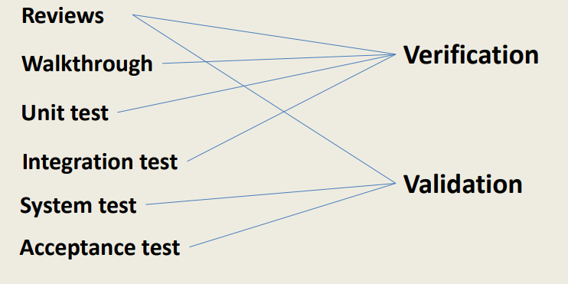
Verification vs. Validation

Slide 19
WRAP UP
Quality Assurance focuses on the developed product is fit for use. For any organization, processes and standard should be followed. It concentrates mainly on the quality of the product/service that we provide to the customers during or after implementation of the software.

